Slide 1
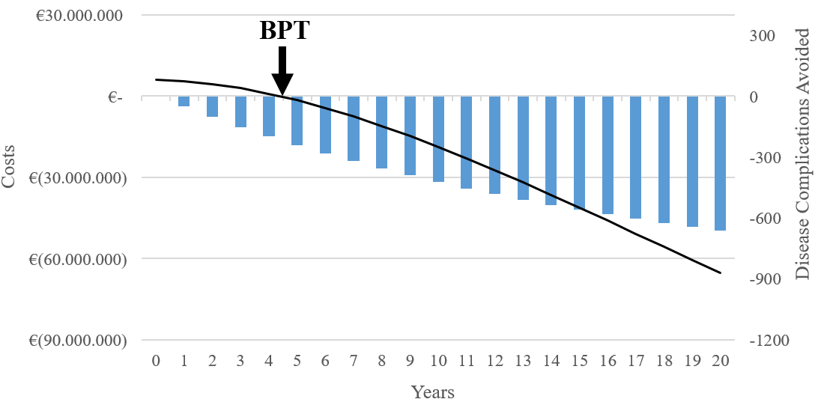
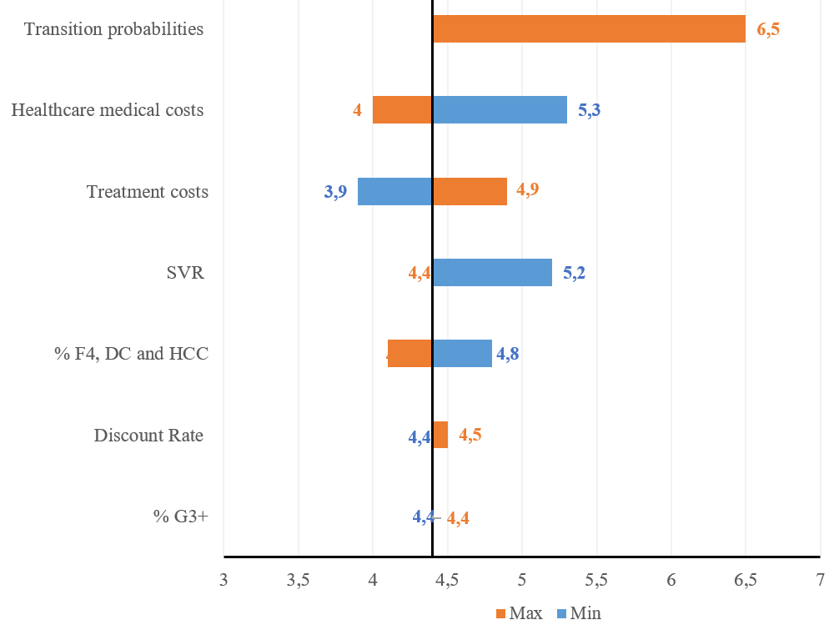
Economic consequences of anti-HCV treatment of patients diagnosed through screening in Italy: a prospective modelling analysis
A. Marcellusi^{1,2}*, C. Simonelli¹*, F.S. Mennini^{1,2}, L.A. Kondili³, on behalf of PITER Collaborating group available at www.progettopiter.it
1
Introduction
4
Results
In order to reach WHO elimination goals for HCV by the year 2030, Italy should maintain the number of treated patients as high as 40,000/year. This is possible through the identification of new patients to treat.
For 1,000 standardized treated patients diagnosed through active HCV screening in Italy, there would be 660 fewer events over the next 20 years (95% CI: 387-870) and €65.22 million (CI 95%: 38.95-133.02) associated savings. It would take 4.4 years (95% CI: 3.41-5.62) to reach the BPT and therefore to recover the initial investment on antiviral treatment.
Avoided complications after 20 years (95% CI) | 660
 | (387 - 870)
Savings after 20 years, € million (95% CI) | € 65.22
 | (€ 38.95 - € 133.02)
BPT years (95% CI) | 4.4
 | (3.41 - 5.62)
2
Aim
To evaluate the cost-consequences of the investment for anti-HCV treatment by the Italian NHS for patients that will be newly diagnosed through active HCV screening, to be implemented in Italy starting from 2020.
The parameters that generate most uncertainty are transition probabilities (+32% variation). The costs of disease management also have a considerable impact on results: High values of costs for disease management costs generate higher cost-savings (+19%) and a lower BPT (-9%) Figure 2.
3
Method
Figure 1 – Disease complications avoided and cost-savings over 20 years and break-even point in time
Figure 2 - DSA: Break-even point in time
A previously published Markov model was used to estimate the disease complications avoided and the associated savings over 20 years to treat a standardized population of 1,000 HCV-infected patients diagnosed as a result of screening.
Disease progression probabilities and fibrosis stage distribution were obtained from literature. Real-life treatment effectiveness and medical expenses for disease management were estimated starting from a representative cohort of HCV treated patients in Italy (Italian Platform for the Study of Viral Hepatitis Therapies - PITER). The breakeven point in time (BPT) was defined as the years required for the initial investment in treatment to be recovered in terms of cumulative costs saved.
Affiliations
5
Conclusions
*Joint First Authors; ¹Economic Evaluation and HTA (EEHTA-CEIS), Centre for Economic and International Studies, Faculty of Economics, University of Rome “Tor Vergata”, Rome, Italy; ²Institute of Leadership and Management in Health, Kingston Business School, Kingston Univeristy, London, UK; ³Center for Global Health, Istituto Superiore di Sanità, Viale Regina Elena 299, 00161 Rome Italy.
Investment in treatment of newly diagnosed patients will bring a significant reduction in disease complications which is associated to great economic benefits.
This type of action can reduce the infection rate and clinical and economic disease burden of HCV infection in Italy.

